Slide 1

AC Milan Squad Enhancement Project
Strategic Investment in Goalkeeping Talent
Club Analysts: Guadalupe, Luísa, Montaseer
Date: 14/05/2024

Slide 2
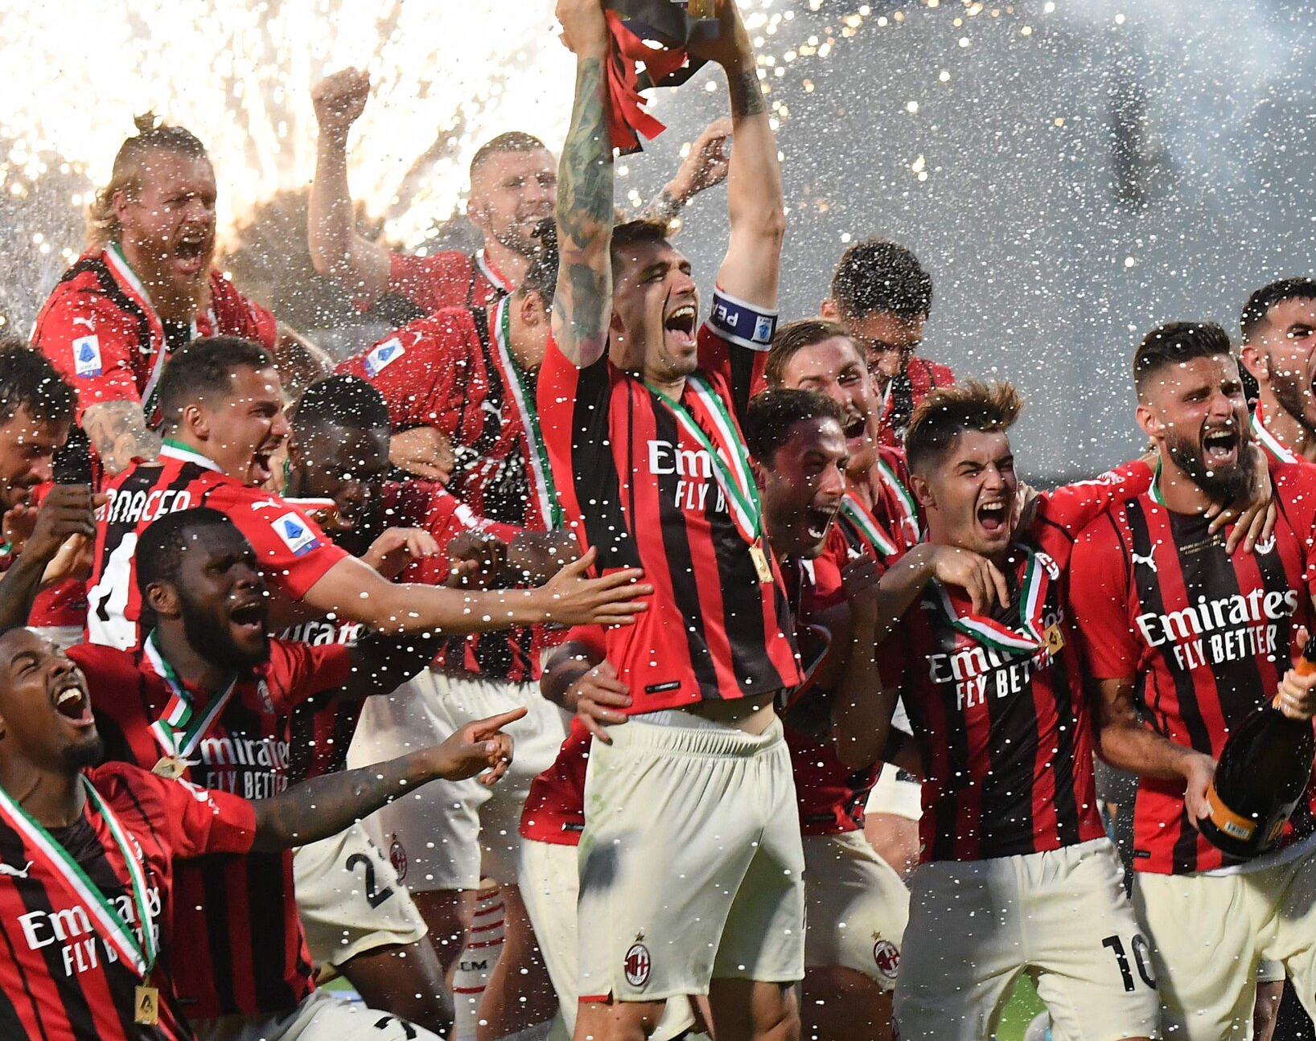
Importance: Strengthening our first and reserve goalkeeper lineup as a foundational step towards a larger team rejuvenation.
Project Overview
Objective: To leverage a €500 million investment to enhance AC Milan's squad starting with the goalkeeping unit to boost the team's potential and competitiveness in international leagues.

Slide 3



Data Information
Source
FIFA 23 Players Dataset
Data Points
Includes comprehensive player attributes such as Overall, Potential, Market Value, and Performance Stats
Volume
Analyzed over 1,000 potential goalkeepers from top leagues globally

Slide 4

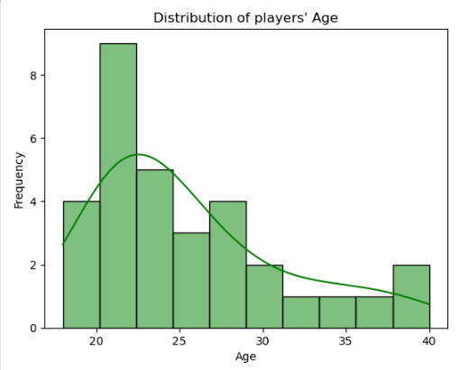
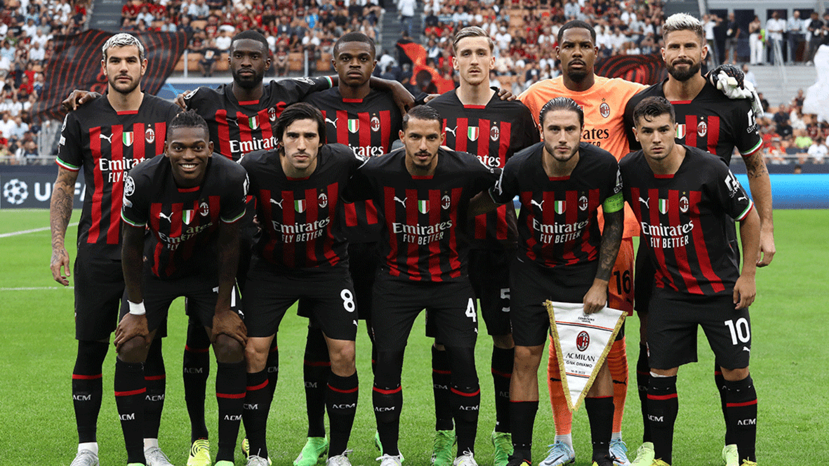
Selecting players to replace
Looking at player’s age distribution

Slide 5

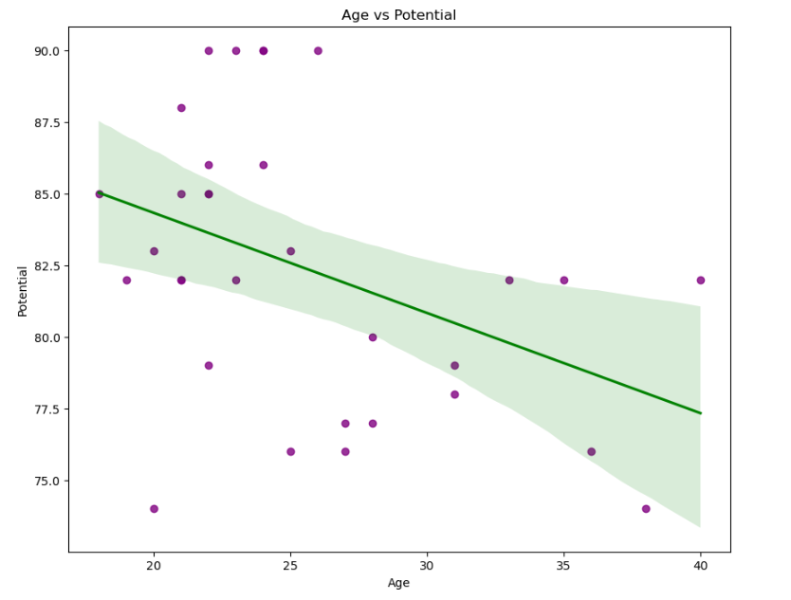
Comparing Age with Potential
Age
Potential

Slide 6

Decision Making
Sell our older players in different stages
Players with more than 30 years
 | Full Name | Overall | Potential | Value (€) | Positions Played | Best Position | Nationality | Age | Club Name | Wage (€) | Release Clause | Club Position | Contract Until
249 | Zlatan Ibrahimović | 82 | 82 | 0 | ST | ST | Sweden | 40 | AC Milan | 63000 | 0 | SUB | 2023
255 | Olivier Giroud | 82 | 82 | 13000000 | ST | ST | France | 35 | AC Milan | 66000 | 22100000 | ST | 2023
256 | Simon Kjær | 82 | 82 | 14500000 | CB | CB | Denmark | 33 | AC Milan | 73000 | 24700000 | SUB | 2024
642 | Alessandro Florenzi | 79 | 79 | 12500000 | RB | RB | Italy | 31 | AC Milan | 60000 | 21300000 | SUB | 2025
710 | Junior Messias | 78 | 78 | 11500000 | RW, RM | RW | Brazil | 31 | AC Milan | 65000 | 19600000 | RW | 2024
1168 | Ciprian Tătărușanu | 76 | 76 | 825000 | GK | GK | Romania | 36 | AC Milan | 25000 | 1400000 | SUB | 2023
2072 | Antonio Mirante | 74 | 74 | 475000 | GK | GK | Italy | 38 | AC Milan | 22000 | 808000 | RES | 2023

Slide 7
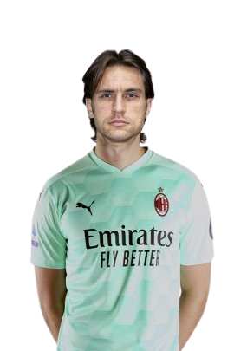

Decision Making
Replace SUB and RES goalkeepers
Ciprian Tătărușanu
Antonio Mirante
Value: €825k
Release Clause: €1.40M
Wage: €25k
End Contract: 2023
Value: €475k
Release Clause: €8.08M
Wage: €22k
End Contract: 2023

Slide 8




Financial Analysis
Team budget for replacements
€500M from investor
Earnings from selling our 2 players €3.51M
TOTAL: €503.508M

Slide 9
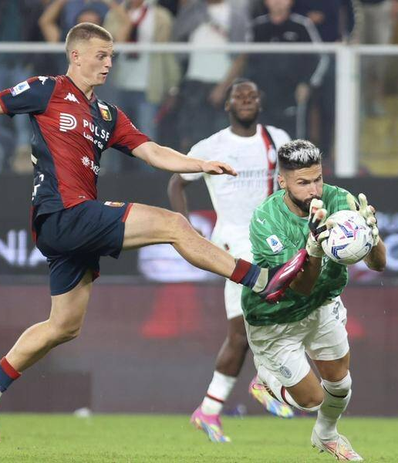

Criteria for new players
Best Position: Goalkeeper
Age: Under 30
Potential: Above 85
Goalkeeper Rating: Above 80

Slide 10

Potential Candidates
 | Full Name | Overall | Potential | Value (€) | Positions Played | Best Position | Nationality | Age | Club Name | Wage (€) | Release Clause | Club Position | Contract Until | GK Rating
14 | Jan Oblak | 89 | 91 | 85500000 | GK | GK | Slovenia | 29 | Atlético de Madrid | 100000 | 181700000 | GK | 2023 | 90
16 | Ederson Santana de Moraes | 89 | 91 | 88000000 | GK | GK | Brazil | 28 | Manchester City | 210000 | 169400000 | GK | 2026 | 90
18 | Alisson Ramses Becker | 89 | 90 | 79000000 | GK | GK | Brazil | 29 | Liverpool | 190000 | 152100000 | GK | 2027 | 90
22 | Gianluigi Donnarumma | 88 | 92 | 103500000 | GK | GK | Italy | 23 | Paris Saint-Germain | 110000 | 199200000 | GK | 2026 | 89
37 | Mike Maignan | 87 | 90 | 80000000 | GK | GK | France | 26 | AC Milan | 90000 | 142000000 | GK | 2026 | 87
165 | Unai Simón Mendibil | 83 | 86 | 37000000 | GK | GK | Spain | 25 | Athletic Club de Bilbao | 30000 | 80500000 | GK | 2025 | 85
171 | Gregor Kobel | 83 | 88 | 44000000 | GK | GK | Switzerland | 24 | Borussia Dortmund | 40000 | 78100000 | GK | 2026 | 84
235 | Aaron Ramsdale | 82 | 86 | 34500000 | GK | GK | England | 24 | Arsenal | 62000 | 68100000 | GK | 2025 | 83

Slide 11

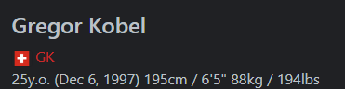

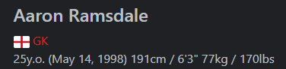

Slide 12
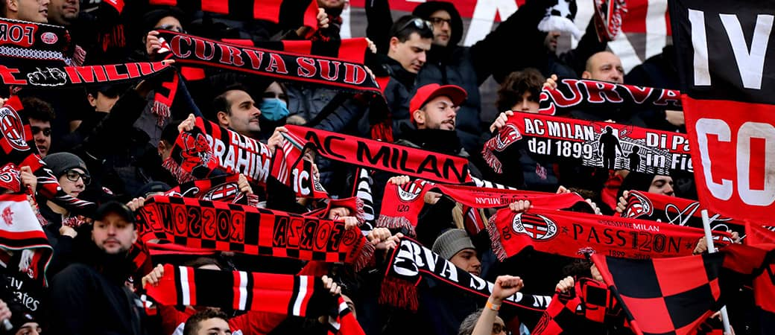
Wage Analysis and
Predictive Modeling
We considered their current wages and created a predictive model to verify whether they are not being overpaid
 | Full Name | Overall | Potential | Value (€) | Positions Played | Best Position | Nationality | Age | Club Name | Wage (€) | Release Clause | Club Position | Contract Until | GK Rating
171 | Gregor Kobel | 83 | 88 | 44000000 | GK | GK | Switzerland | 24 | Borussia Dortmund | 40000 | 78100000 | GK | 2026 | 84
235 | Aaron Ramsdale | 82 | 86 | 34500000 | GK | GK | England | 24 | Arsenal | 62000 | 68100000 | GK | 2025 | 83

Slide 13

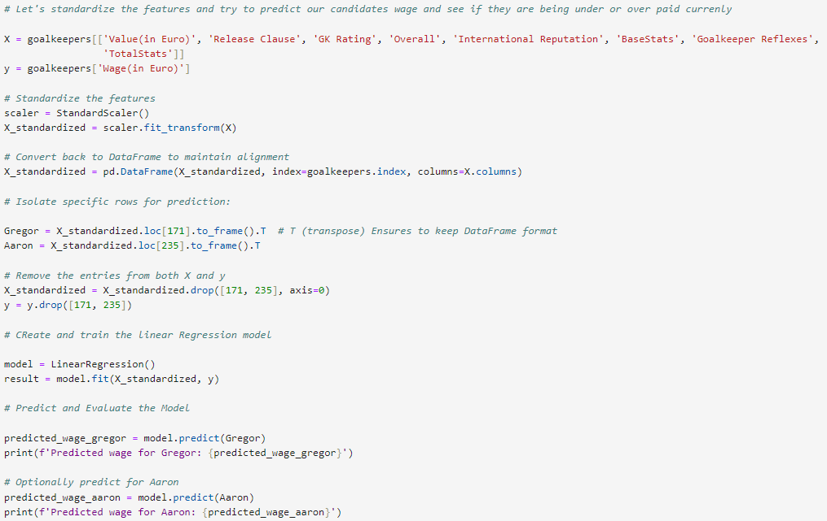
Our Model’s Score
Predicted wage for Gregor
[78169.61137425]
Predict wage for Aaron
[60970.83519836]
Training Set R² Score 0.7382713375088554

Slide 14
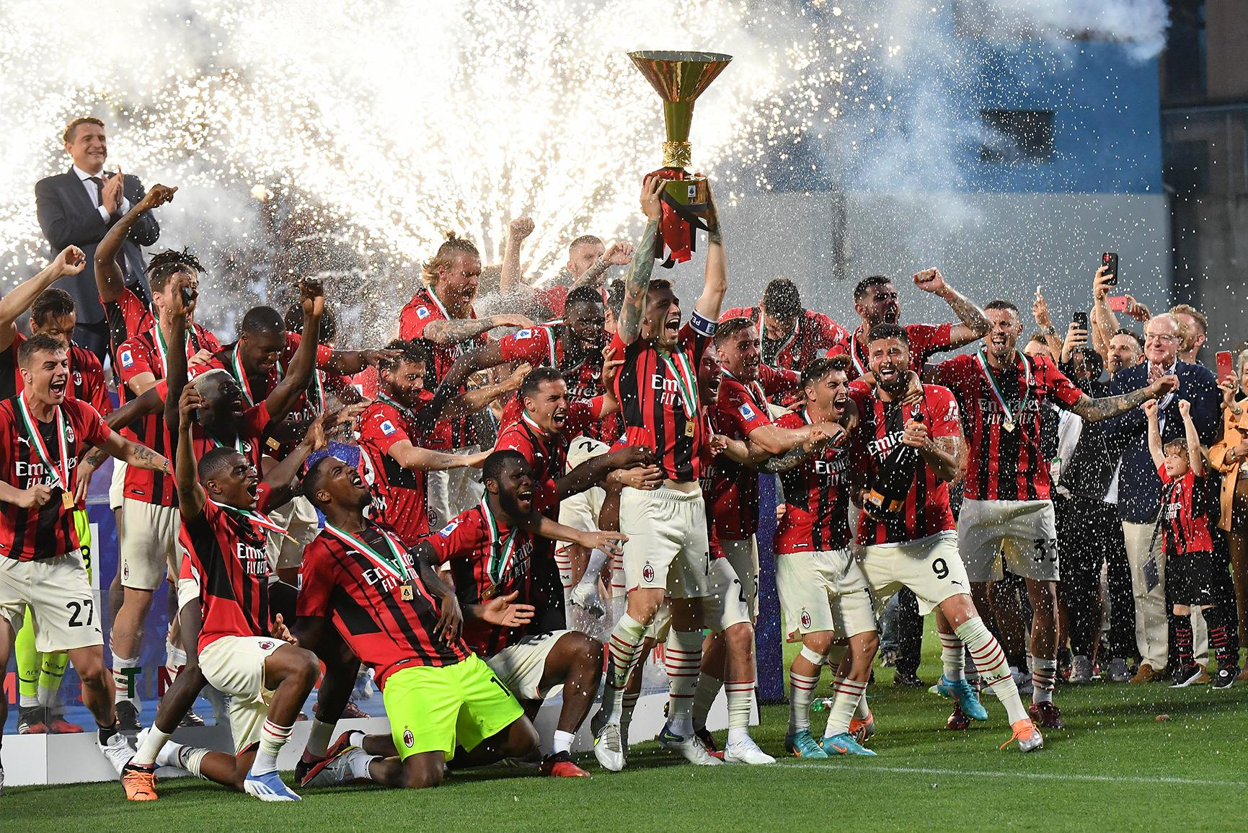
Conclusions
Concluding this initial phase, we evaluated our team's potential following the recent changes and successfully increased it by one point.
We will proceed with subsequent phases, focusing on assessing other players and necessary substitutions to further enhance our team's potential.
AC Milan’s Average Potential
82.357 83.125
Before
After

